Slide 1
Bayesian Prompt Learning for Image-Language Model Generalization
Mohammad Mahdi Derakshani et al.
Jonathan Hu
ECSE 626
Dec 3, 2025

Slide 2
Few-Shot Learning in the Real World
Why do we care about few-shot learning?
Modern VLMs like CLIP are trained once on large dataset of image-text pairs
Zero-shot CLIP performance is good, but not excellent
In the real world, we face new, specialized tasks where:
Labeled data is scarce
Finetuning entire model is undesirable
Objective: Adapt a pre-trained, frozen model like CLIP to a novel downstream task using very few labeled samples (few-shot regime)
Robust to distribution shift and out-of-distribution examples (generalization)

Slide 3
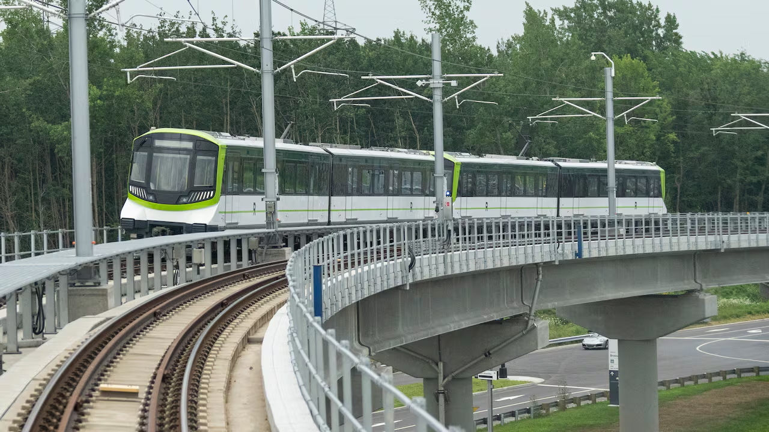
Anomaly Detection
CBC News

Slide 4
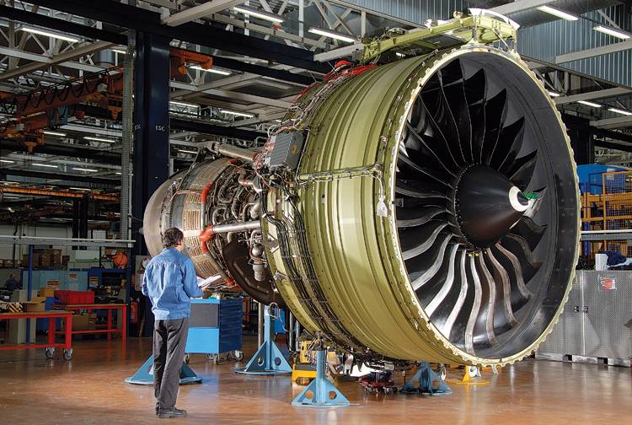
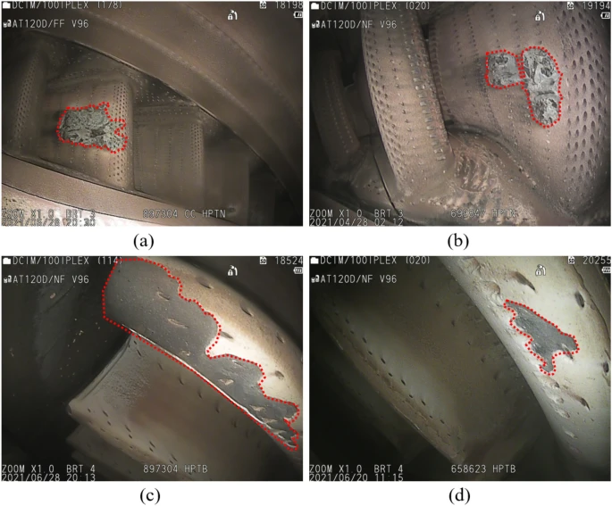
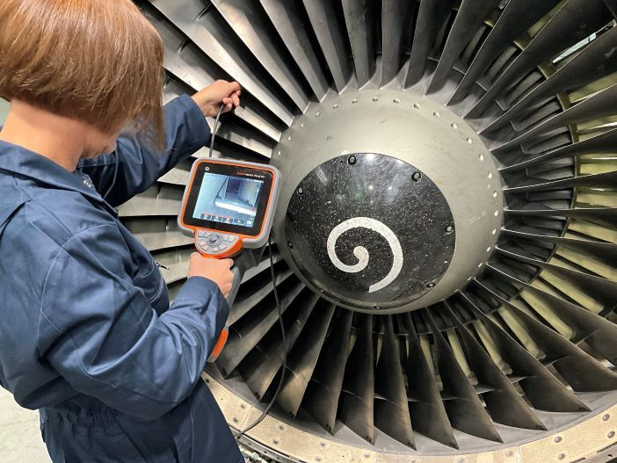
Jet Engine Inspection
Deep learning-based defects detection of certain aero-engine blades and vanes with DDSC-YOLOv5s [Li et al., 2022], SP’s Airbuz,

Slide 5
Existing Methods: CoOp/CoCoOp/ProDA
What’s been tried?
Context Optimization (CoOp)
Single global soft prompt
Good in-domain, weaker on unseen classes
Conditional Context Optimization (CoCoOp)
Prompt residual conditioned on image
Better unseen-class & cross-dataset generalization
ProDA
Learn an ensemble of prompts
Fit a multivariate Gaussian over classifier weights, use mean at test time

Slide 6
Bayesian Prompt Learning
ProDA
Learn a distribution over the output embeddings of the prompts
Still deterministic at inference (no sampling)
Can not condition prompts on the image
Bayesian Prompt Learning
Learn a distribution over input embeddings of the prompts
Sample the learned distribution at test time
Unconditional and conditional

Slide 7
Theory time!

Slide 8
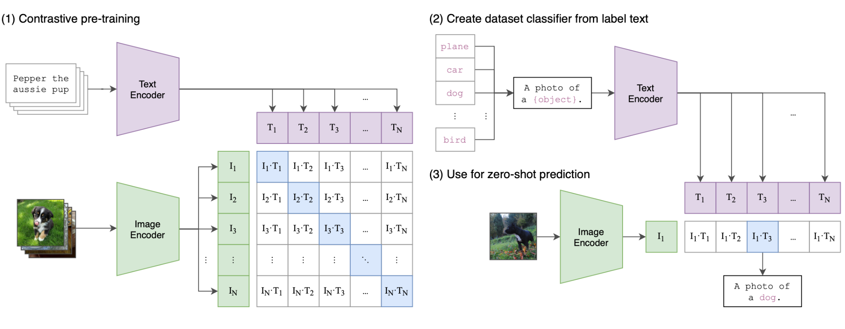
CLIP Recap
Learn joint embedding of image and text via contrastive learning
Learning Transferable Visual Models From Natural Language Supervision [Radford et al., 2021]

Slide 9
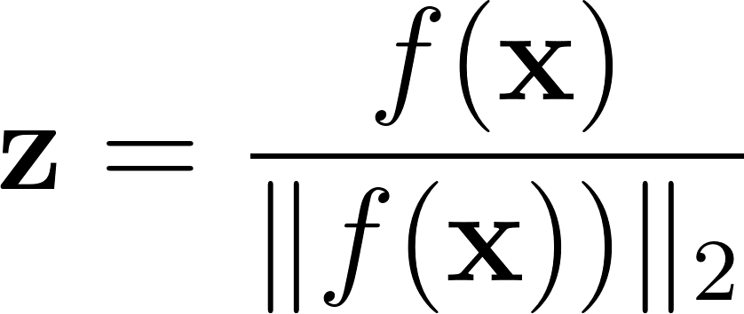


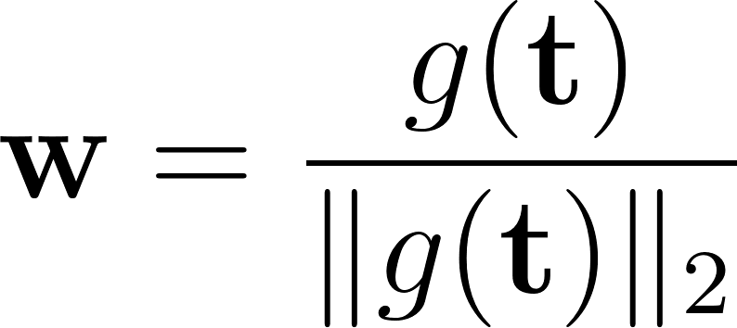

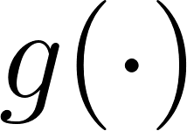
VLM Recap
Normalized image embedding
: image
: image encoder
Normalized text embedding
: text
: text encoder
Learning Transferable Visual Models From Natural Language Supervision [Radford et al., 2021]

Slide 10
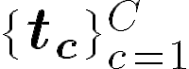

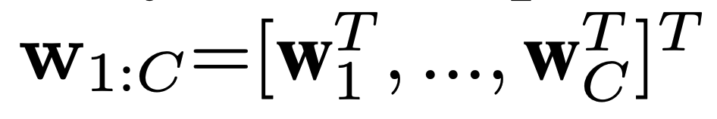
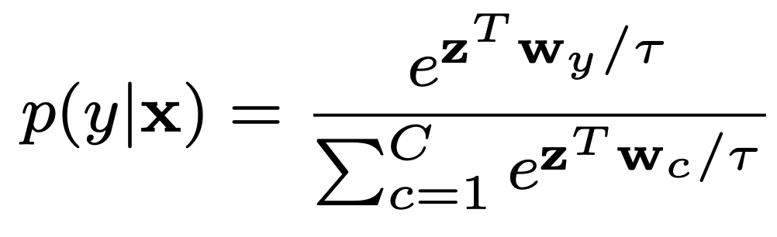
Zero-shot CLIP for Image Classification
Generate category descriptions
: number of classes
Generate text embedding w for each category
Prediction probability of class y for test sample x
Learning Transferable Visual Models From Natural Language Supervision [Radford et al., 2021]

Slide 11
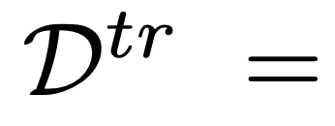
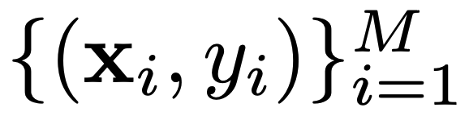
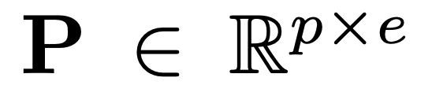
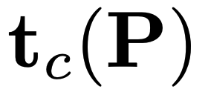

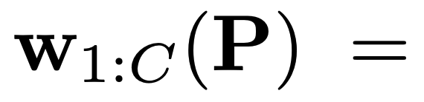
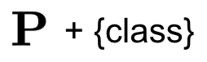
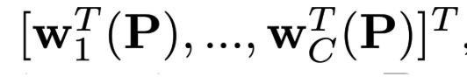
Context Optimization (CoOp)
Learn prompt P with a few training samples
Learnable continuous prompt
= + {class}
Randomly initialized
Learning Transferable Visual Models From Natural Language Supervision [Radford et al., 2021]

Slide 12
Limitation: Overfitting to Seen Classes
In few-shot settings, CoOp tends to:
Learn prompts that are highly tuned to the training classes even with data augmentation
Hurts performance on new / unseen classes or shifted domains
Why?
We train one fixed prompt to fit the labeled training set as well as possible
The model has no notion of uncertainty over prompts: it commits to one very specific solution

Slide 13
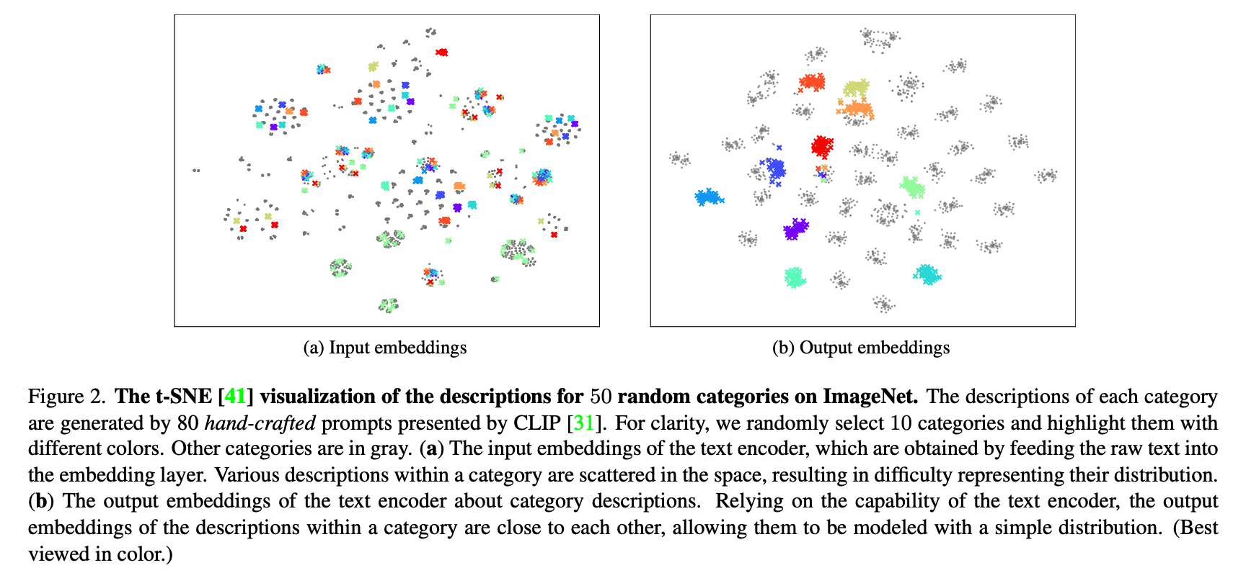
Input vs Output Embeddings
= + {class}
Prompt Distribution Learning [Lu et al., 2022]

Slide 14
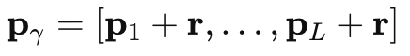
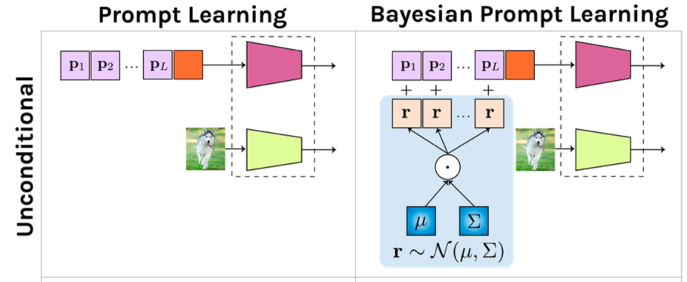
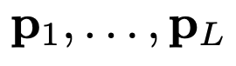
Unconditional Bayesian Prompt Learning
From a single prompt to a distribution
Represent each prompt as base + residual:
Introduce a latent residual r
same r applied to all prompt tokens
𝑟 is random, drawn from a learned distribution
Base tokens​ are still learned
Unconditional BPL:
Distribution over 𝑟 does not depend on image 𝑥

Slide 15
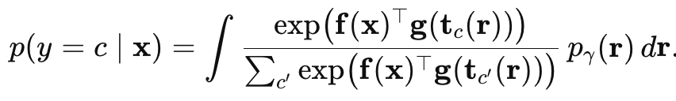
In an ideal world…
Find the posterior distribution over residual r that maximizes the marginal likelihood:
Intractable to integrate over the entire 512-D prompt space
real posterior distribution over r

Slide 16
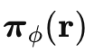
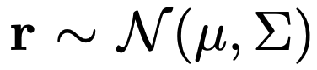
Variational Inference & ELBO
Introduce a surrogate distribution over residuals
prior defined as N(0,I)
Learn a surrogate Gaussian distribution that that maximizes the marginal likelihood (optimality)
How? By maximizing the variational bound (ELBO)
data fit term
regularization term

Slide 17
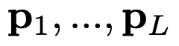
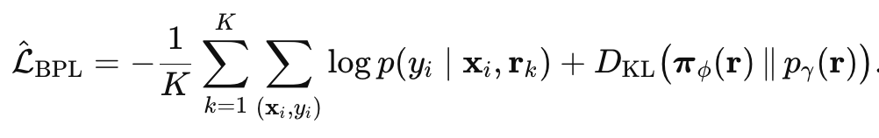
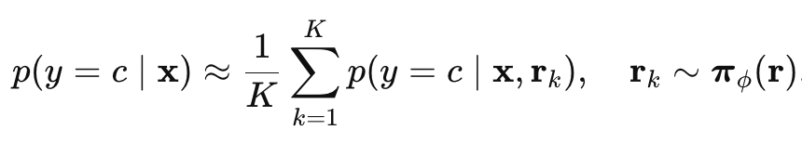
Optimization & Inference (Unconditional)
How do we train and use it?
CLIP encoders 𝑓, 𝑔 frozen
Learn
base prompt tokens
mean and covariance
Training
Reparameterization trick
Monte Carlo training objective:
Inference (test time)

Slide 18
Results

Slide 19
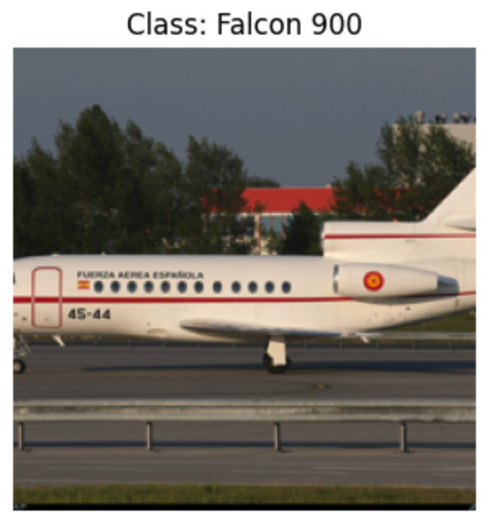
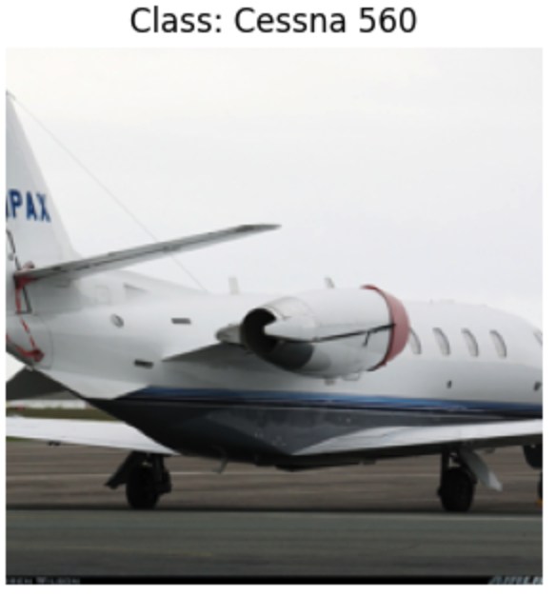
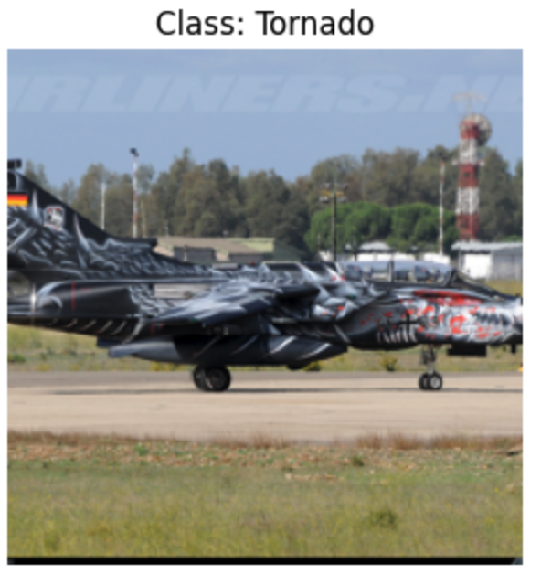
Experimental Setup: FGVCAircraft
Dataset: FGVCAircraft (fine-grained aircraft recognition)
100 classes, 100 images per class
Backbone: ViT-B/16
Few-shot regime: 16 shots per class for training
Class split
Base classes = used for training prompts
Novel classes = held out, test generalization
Baselines
Zero-shot CLIP
CoOp
Unconditional BPL
Source: FGVCAircraft

Slide 20
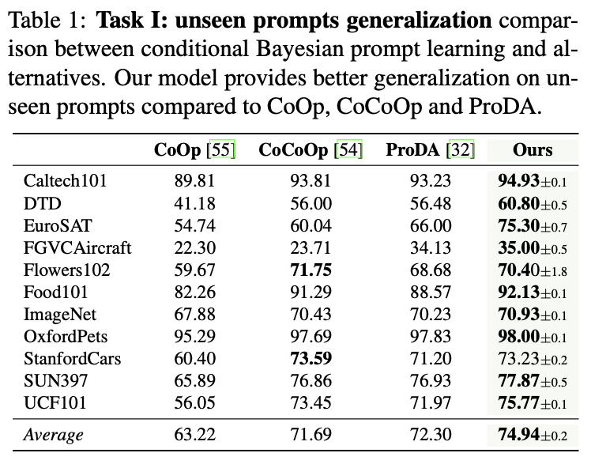
Overview of paper’s results

Slide 21

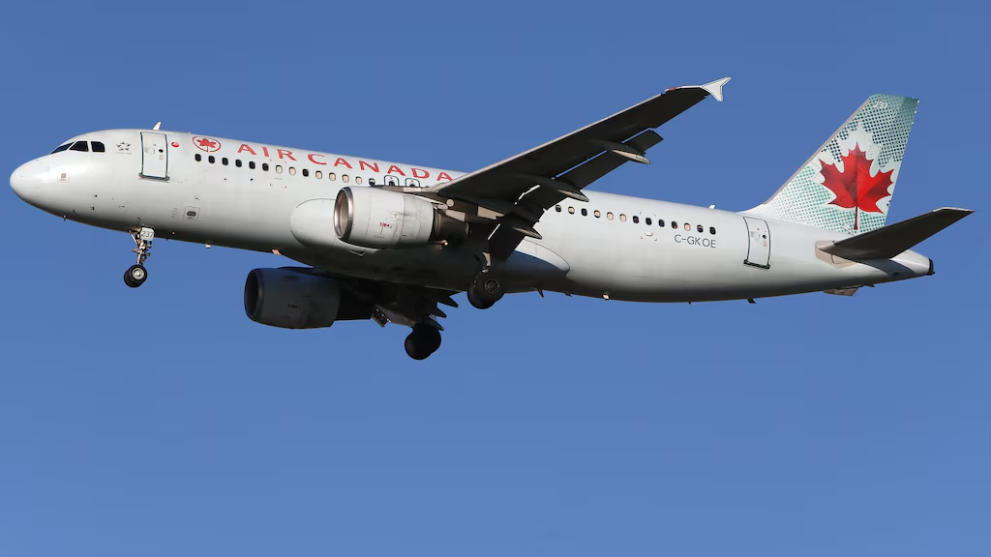
Manufacturer
Boeing or Airbus
Source: Wikipedia, Radio-Canada

Slide 22
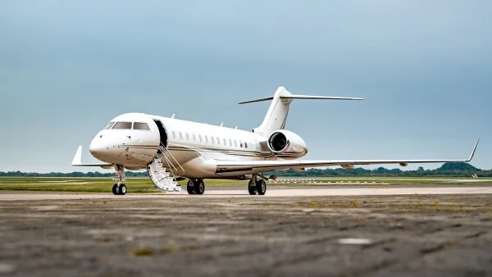
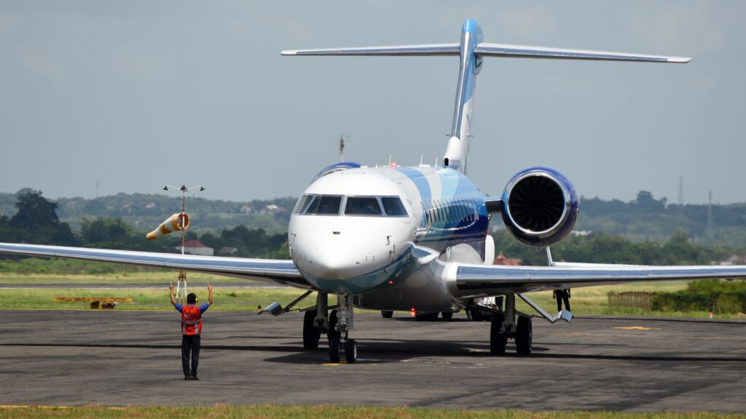
Variant
Example: Bombardier Global 6500 vs Global 7500
Source: Bombardier

Slide 23
Results: Accuracy
Context Optimization (CoOp)
Image transforms
Random resized crop
Random horizontal flip
Epochs: 200
Trained on all 100 classes
3 seeds
Approach | Dataset | Backbone | Context length | Shots | CoOp | Ours
Context Optimization | FGVC Aircraft | ViT-B/16 | 4 | 16 | 40.27% | 39.67%
Context Optimization | FGVC Aircraft | ViT-B/16 | 8 | 16 | 42.57% | 41.90%
Context Optimization | FGVC Aircraft | ViT-B/16 | 16 | 16 | 43.53% | 43.78%
Learning to prompt for vision-language models [Zhou et al., 2022]

Slide 24
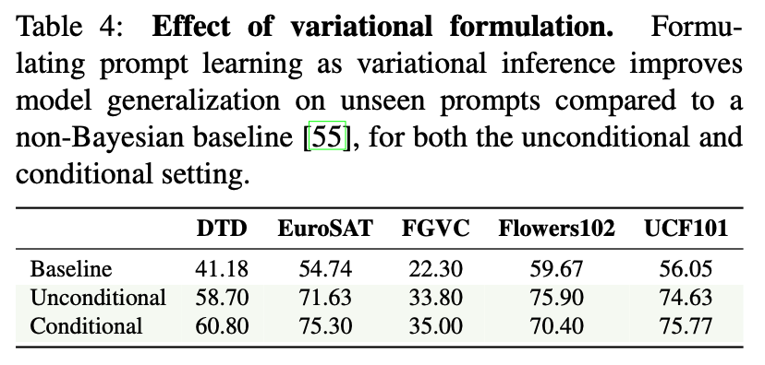
Results: Accuracy
Task I: Unseen Prompts Generalization
100 classes
Train on half of the classes
Test on unseen half
BPL
Reduced context length from 16 to 4
10 MC samples, 10 epochs
Approach | Dataset | Backbone | Context length | MC Samples | Epochs | BPL | Ours
BPL - Unconditional | FGVC Aircraft | ViT-B/16 | 4 | 10 | 10 | 34.17% | 34.45%
BPL - Unconditional | FGVC Aircraft | ViT-B/16 | 8 | 10 | 10 | 32.53% | 31.61%
BPL - Unconditional | FGVC Aircraft | ViT-B/16 | 16 | 10 | 10 | 31.10% | 30.39%
Bayesian Prompt Learning [Derakshani et al., 2023]

Slide 25
Results: Accuracy
Task I: Unseen Prompts Generalization
100 classes
Train on half of the classes
Test on unseen half
BPL: Reduced context length from 16 to 4
Approach | Dataset | Backbone | Context length | Shots | Original | Ours
Zero-shot CLIP | FGVC Aircraft | ViT-B/16 |  |  |  | 23.13%
Context Optimization | FGVC Aircraft | ViT-B/16 | 4 | 16 | 22.30% | 25.25%
BPL - Unconditional | FGVC Aircraft | ViT-B/16 | 4 | 16 | 34.17% | 34.45%
Bayesian Prompt Learning [Derakshani et al., 2023]

Slide 26
Results: Accuracy
Task I: Unseen Prompts Generalization
Weak baseline in the paper
200 epochs + 4 tokens = overfitting
BPL still better than CoOp, but improvement not as dramatic
Approach | Dataset | Backbone | Context length | Shots | Epochs | Ours
Context Optimization | FGVC Aircraft | ViT-B/16 | 4 | 16 | 200 | 25.25%
Context Optimization | FGVC Aircraft | ViT-B/16 | 4 | 16 | 100 | 27.17%
Context Optimization | FGVC Aircraft | ViT-B/16 | 4 | 16 | 75 | 27.63%
Context Optimization | FGVC Aircraft | ViT-B/16 | 4 | 16 | 50 | 28.33%
Context Optimization | FGVC Aircraft | ViT-B/16 | 4 | 16 | 25 | 30.41%
BPL - Unconditional | FGVC Aircraft | ViT-B/16 | 4 | 16 | 10 | 34.45%
Bayesian Prompt Learning [Derakshani et al., 2023]

Slide 27
Discussion

Slide 28
Key modeling assumptions
Global residual: a single vector r shifting all prompt tokens captures useful prompt variability
Gaussian residual distribution: residuals live roughly in a single Gaussian blob in the text-embedding space
Frozen CLIP encoder

Slide 29
Overview
Pros:
Simple conceptual change: one global latent 𝑟
Easy to implement on top of CoOp.
Acts as a Bayesian regularizer in prompt space, improving generalization to unseen classes.
Weaknesses:
Extra cost at inference due to sampling (though small for modest 𝐾)
Gaussian form of the surrogate residual distribution may not accurately capture prompt distribution
Little improvement over past approaches on certain tasks/datasets

Slide 30
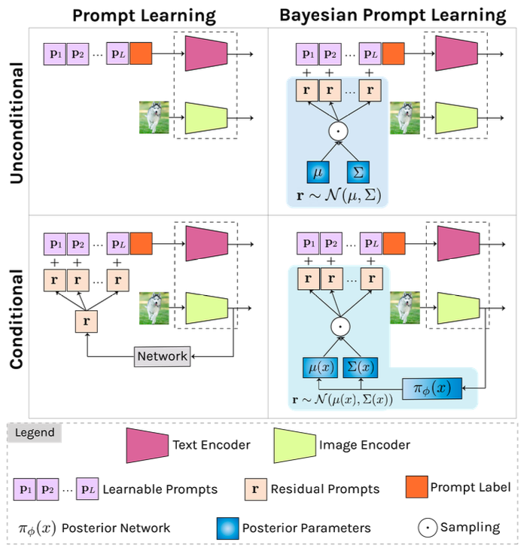
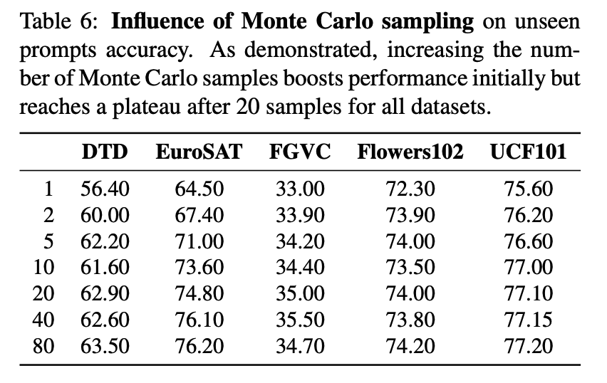
Ablation on MC Samples
Where does it break?
Table 6 is Conditional BPL
Bayesian Prompt Learning [Derakshani et al., 2023]

Slide 31
Ablation on MC Samples
Where does it break?
Performance of unconditional BPL diverges significantly from conditional BPL in low MC sample regime
 |  |  | BPL |  |  |  | Ours
Approach | MC Samples | Epochs | Seed 1 | Seed 2 | Seed 3 | Average | Seed 1 | Seed 2 | Seed 3 | Average
BPL - Unconditional | 1 | 10 | 3.30% | 4.00% | 4.10% | 3.80% | 2.70% | 31.91% | 1.38% | 12.00%
BPL - Unconditional | 2 | 10 | 22.70% | 4.70% | 5.40% | 10.93% | 5.52% | 1.44% | 27.11% | 11.36%
BPL - Unconditional | 5 | 10 | 34.20% | 34.90% | 32.70% | 33.93% | 28.19% | 34.13% | 36.23% | 32.85%
BPL - Unconditional | 10 | 10 | 34.80% | 33.70% | 34.00% | 34.17% | 34.73% | 34.07% | 34.55% | 34.45%
Bayesian Prompt Learning [Derakshani et al., 2023]

Slide 32
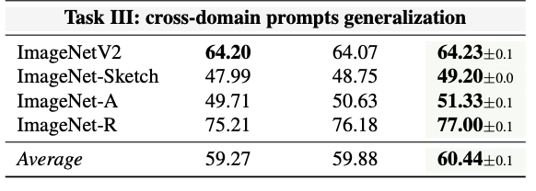
Task III

Slide 33
Impact
First to frame prompt learning from Bayesian perspective and formulate it as variational inference problem
Models input prompt space in probabilistic manner which is compatible with prompt learning approaches that condition on the image
Demonstrated positive impact of Bayesian regularization on generalization to unseen prompts across different datasets and domains

Slide 34
Questions
Why do you think CLIP-based models still perform poorly on fine-grained classification tasks like FGVCAircraft?
What are the fundamental limitations of prompt learning in the text embedding space?
In what situation would the Gaussian assumption over the residual distribution break?
Why do you think the performance collapsed when the number of MC samples was reduced?

Slide 35
References
Mohammad Mahdi Derakhshani, Enrique Sanchez, Adrian Bulat, Victor Guilherme Turrisi da Costa, Cees GM Snoek, Georgios Tzimiropoulos, and Brais Martinez. Bayesian prompt learning for image-language model generalization. ICCV, 2023
Yuning Lu, Jianzhuang Liu, Yonggang Zhang, Yajing Liu, and Xinmei Tian. Prompt distribution learning. In Proceedings of the IEEE/CVF Conference on Computer Vision and Pattern Recognition (CVPR), pages 5206–5215, June 2022.
Kaiyang Zhou, Jingkang Yang, Chen Change Loy, and Ziwei Liu. Conditional prompt learning for vision-language models. In IEEE/CVF Conference on Computer Vision and Pattern Recognition (CVPR), 2022.
Kaiyang Zhou, Jingkang Yang, Chen Change Loy, and Ziwei Liu. Learning to prompt for vision-language models. International Journal of Computer Vision (IJCV), 2022.
Alec Radford, Jong Wook Kim, Chris Hallacy, Aditya Ramesh, Gabriel Goh, Sandhini Agarwal, Girish Sastry, Amanda Askell, Pamela Mishkin, Jack Clark, Gretchen Krueger, and Ilya Sutskever. Learning transferable visual models from natural language supervision. In Proceedings of the 38th International Conference on Machine Learning, volume 139 of Proceedings of Machine Learning Research, pages 8748–8763. PMLR, 18–24 Jul 2021.

Slide 36
Input vs Output Embeddings
= + {class}
Prompt Distribution Learning [Lu et al., 2022]

Slide 37
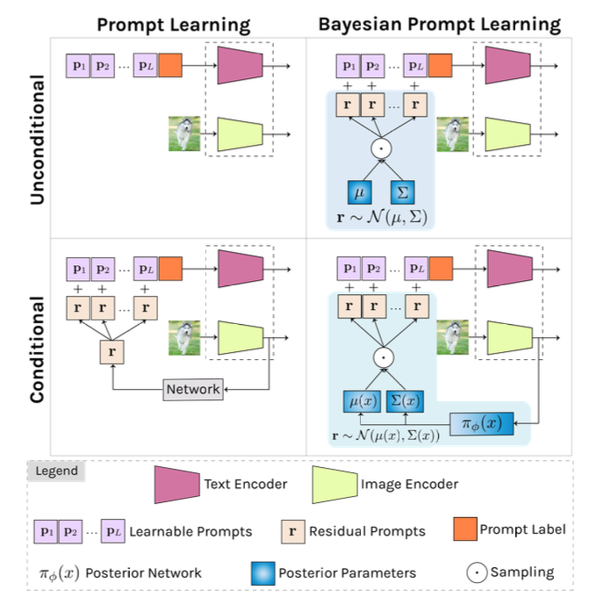
Overview

